Slide 1

FPGA platform applied for facial expression recognition using CNNs
Ho Chi Minh City University of Technology
Faculty of Electrical & Electronics Engineering
Department of Telecommunications Engineering
Instructor: Prof. Dr. Thuong Le-Tien
Conducted by: Sy Nguyen-Tan
Ho Chi Minh City University of Technology.
Date: June 21st, 2019

Slide 2
Content
Abstract
Problem definition
Model Implementation
Hardware Design
Experimental results
Conclusion

Slide 3
Abstract

Slide 4
About this template
Abstract
Cameras are used everywhere as flexible sensors for numerous applications
A required image processing should be local on embedded computer platforms with performance requirements and energy constraints
A challenging problem is the design of efficient accelerators for that purpose, since some CNNs require a lot of repetitive image processing
I show and implement solutions to quantize the trained CNN as well as perform and optimize computations on an Embedded System
The design flow is evaluated by implementing the previously trained CNN to recognize facial emotions from face image implemented in python on a PC
The project explains the process of porting the CNN algorithm from python to C/C++ and then executing it on a ZYNQ FPGA board
The bottleneck of the CNN is the convolutional layers and that is why different solutions for that accelerator are analysed and some of them implemented on VHDL, connected to the embedded processor and their performance is tested.

Slide 5
Problem Definition

Slide 6
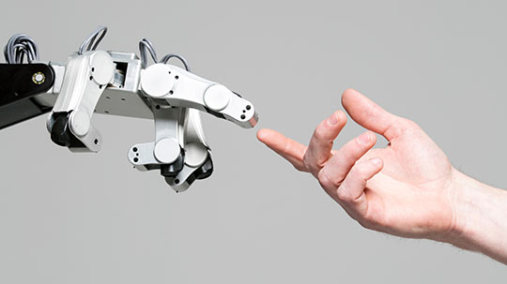
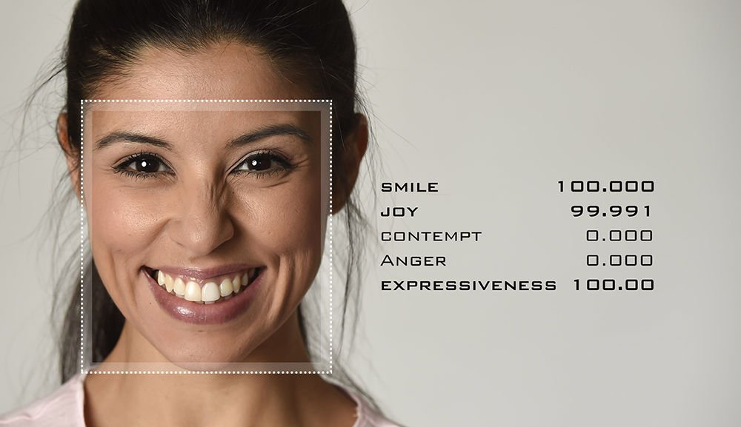
About this template
Problem Definition
Figure [1]: Human- Robot Interaction
Figure [2]: Emotion Recognition
Human- Robot interaction is increasing its attention.
=> Understanding the facial gestures and visual cues of an individual is a need
FER system allows a robot to understand the expression of humans in turn enhancing its effectiveness in performing various tasks
Source: [1][2] Internet

Slide 7

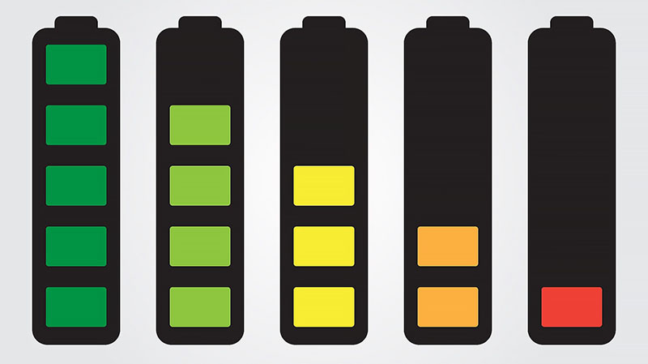
About this template
Problem Definition
Figure [3]: Artificial Intelligence Development
Figure [4]: Energy consumption Problem
In recent years, the development of artificial intelligence opens up the opportunity to create more complex systems to bring people and robots closer together.
“The energy industry is facing decades of transformation”[5]. Yet the implications of the changes underway go far deeper. There are political, economic and social issues at stake, but it may also require each of us to make some fundamental shifts in our behavior too.
Source: [3][4] Internet
[5] 2016 World Energy Scenarios, World Energy Council, https://www.worldenergy.org/wp-content/uploads/2016/10/World-Energy-Scenarios-2016_Full-Report.pdf

Slide 8
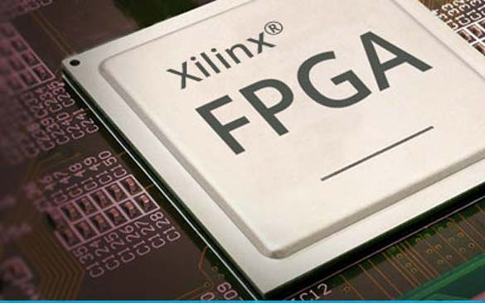
About this template
Problem Definition
Table [7] | GPU | FPGA
Execution Time (s) | 18.7 | 21.4
Power Consumption (W) | 30 | 15
Figure [6] FPGA acceleration
Furthermore, reduced data precision allows FPGA to reach performance in range of Tera-Operations per second
Source: [6]: Xilinx FPGA Power, https://www.renesas.com/us/en/solutions/key-technology/fpga-power-solutions/fpga-power-xilinx.html
[7]: Wonlai Zhao, Haohuan Fu, Wayne Luk, “F-CNN: An FPGA-based framework for training Convolutional Neural Network” 2016, IEEE 27th International Conference on Application-specific System, Architecture and Processors (ASAP)

Slide 9
Model Implementation

Slide 10
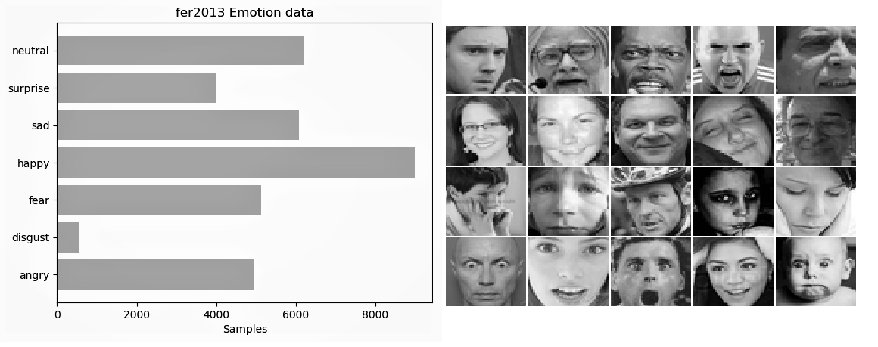
About this template
Dataset
[8] | Training set | Public testing set | Private testing set
Image Quantity (sample) | 28709 | 3589 | 3589
Figure [9] Structure of FER-2013 dataset
Table [10] FER-2013 details
FERC-2013 has seven categories (0=Angry, 1=Disgust, 2=Fear, 3=Happy, 4=Sad, 5=Surprise, 6=Neutral) [9]
Source: [8] Internet
[9][10] Kaggle, FER2013, https://www.kaggle.com/deadskull7/fer2013.

Slide 11
About this template
Dataset
 | Image Quantity (sample)
Emotion | Angry Disgust Fear Happy Sad Surprise Neutral | 4953 547 5121 8989 6077 4002 6198
Figure [11] Structure of FER-2013 dataset
Table [12] FER-2013 details
Source: [11][12] Kaggle, FER2013, https://www.kaggle.com/deadskull7/fer2013.

Slide 12
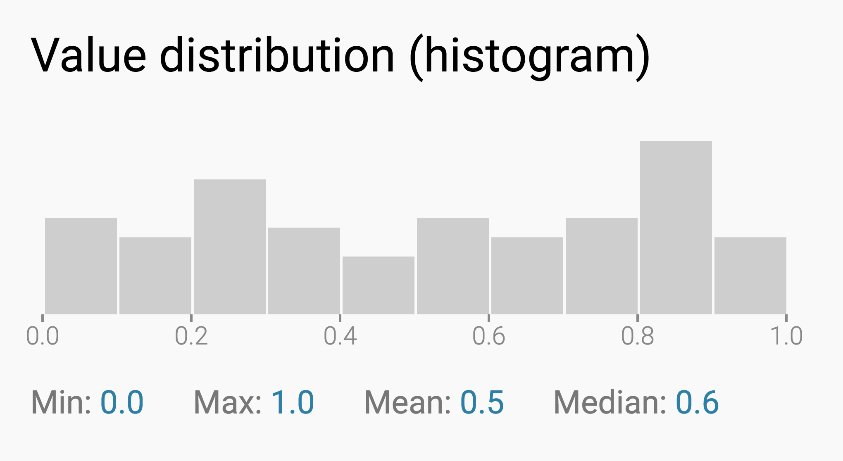
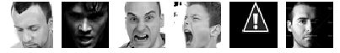
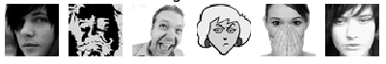
About this template
Dataset Cleaning
1. Remove strange data
Figure [13] Some wrong image in FER-2013
Figure [14] Example of histogram distribution
There are some images that are not good (e.g. some images are pixelated, irrelevant, from animations)
⇨⇨ The maximum of the histogram
Source: [13] Kaggle, FER2013, https://www.kaggle.com/deadskull7/fer2013.
[14] Internet

Slide 13
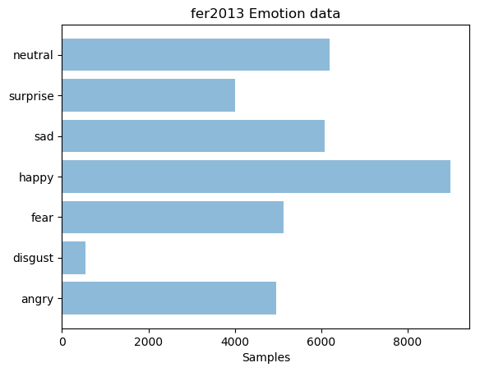
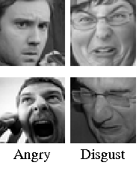
About this template
Dataset Cleaning
2. Merge class 0 and 1
⇨⇨ Merger class 0 and 1 together
The recognized emotions and labels are reduced to 6:
0-(Angry + Disgust)
1-Fear
2-Happy
3-Sad
4-Surprise
5-Neutral
Figure [15] FER-2013 structure
Figure [16] Angry and Disgust samples
Class 1 has a very small amount
This class, (disgust) is very similar to anger
Source: [15] Internet
[16] Kaggle, FER2013, https://www.kaggle.com/deadskull7/fer2013.

Slide 14
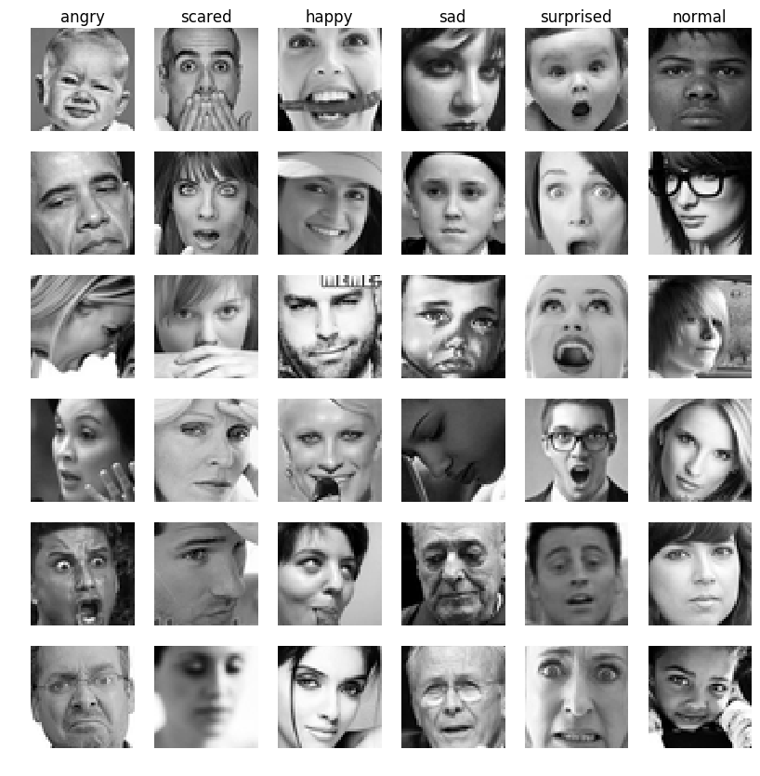
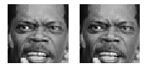
About this template
The correct data
31097 are left after 'strange images' removal.
Deleted 1695 strange images.
⇨ The data is ready for preparation
The data are a little bit modified to be correctly fed into the CNN
Convert, normalize and subtract the const mean value from the data images
Label values of the classes are converted to a binary one_hot vector.
Figure [18] Data after finishing preparation
Figure [17] FER-2013 correct data
Source: [17] Kaggle, FER2013, https://www.kaggle.com/deadskull7/fer2013.

Slide 15
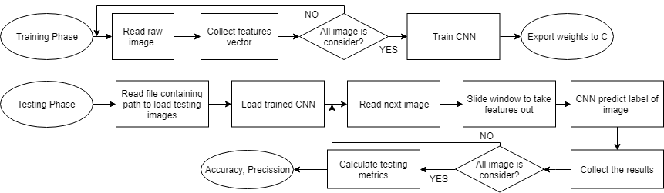
About this template
Proposed System
Figure [19] PC-stage diagram
The GPU based processing is divided into 2 stages including training and testing process. After finishing the deployment of the system on the computer, the weights of the model is exported and downloaded to the FPGA system.

Slide 16
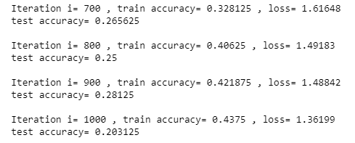
About this template
CNN Architecture
1. Model 1 - Overfitting the data TODO not overfitting with 35k data
A baseline softmax classifier using a single convolutional layer and a one fully connected layer
The equation of the classifier is simply:
Y= softmax(ReLU(x*W₁ +b₁)W₂+b₂)
64 filters with size 8x8.
AdamOptimizer with a learning rate of 0.004
Figure [20] Training Process of model 1
The model was overfitting
test accuracy of only 28%.
It could not find any features with this architecture

Slide 17
About this template
CNN Architecture
Solution
More advanced architectures.
Since the first convolutional layer will just extract some simplest characteristics of the image such as edges, lines and curves
Apply different techniques such as
dropout and pool
implement a neural network of more layers
Balance dataset
The amount of "happy" images was even
bigger(8k), that is why we decided to skip
3k random "happy" class images
Figure [15] FER-2013 structure
Source: [15] Internet

Slide 18
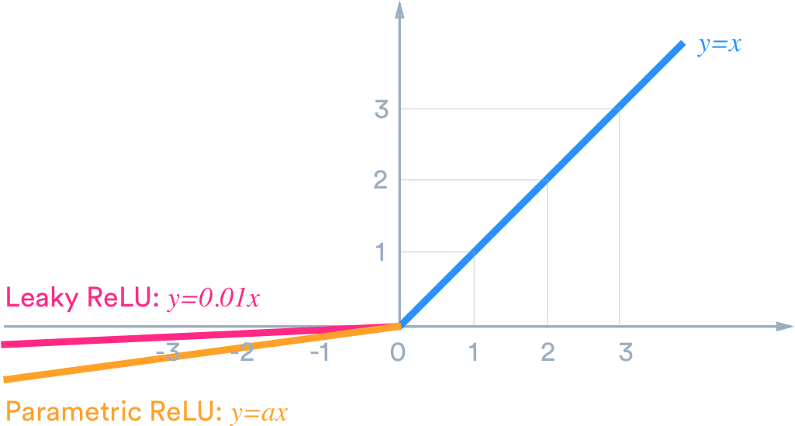

About this template
CNN Architecture
Solution more advanced architectures
Techniques :
Choosing Hyperparameters
the number and dimension of the filter
the number of layers,
ReLU non linear function f(x) = max(0, x)
Pooling Layers
Dropout Layers
Figure [21] ReLU-non linear function
Figure [22] Dropout structure
Source: [21][22] Internet

Slide 19
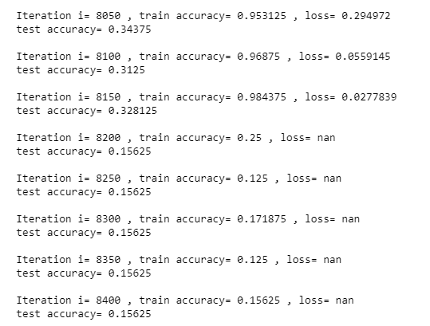
About this template
CNN Architecture
2. Model 2 - 4 x Convolutional Layers, 1x Fully Connected
Comment
This second model has better performances compared to the first one
Reaches a test accuracy up to 35% while still showing overfitting.
After few iterations it finished learning stucking on 0.15625 of test accuracy
⇨ This model has been discarded.
Figure [23] Training Process of model 2

Slide 20
About this template
CNN Architecture
2. Model 2 - 4 x Convolutional Layers, 1x Fully Connected
The second model consists of a 4 layer convolutional layer with a final fully connected layer.
The equation of the classifier is simply:
x= maxpool2x2(ReLu(ReLU(x*W₁ +b₁)W₂+b₂))
2 times (also for W₃,b₃,W₄,b₄
y= softmax(xW₅+b₅)
1,2,3 layers, 16 filters with a dimension of 7x7
4,5,6 a dimension of 5x5
AdamOptimizer with a learning rate of 0.001 s.

Slide 21
About this template
CNN Architecture
3. Model 3: Computational graph - 6 Layers, Conv-Relu-Maxpool, 1 Fully Connected
The third model consists in a 6 layer convolutional layers with a final fully connected layer.
The equation of the classifier is simply:
x1= maxpool2x2(ReLu(ReLU(x*W₁ +b₁)W₂+b₂))
2 times (also for W₃,b₃,W₄,b₄)
x2 = ReLU(x₁*W₅+b5)
There is 1 additional conv layer and finally a fully connected layer at the end.
y= softmax(x₂*W₆+b₆)
1,2,3 layers, 22 with a dimension of 8x8
4,5,6 a dimension of 4x4
AdamOptimizer with a learning rate of 0.001 s.

Slide 22
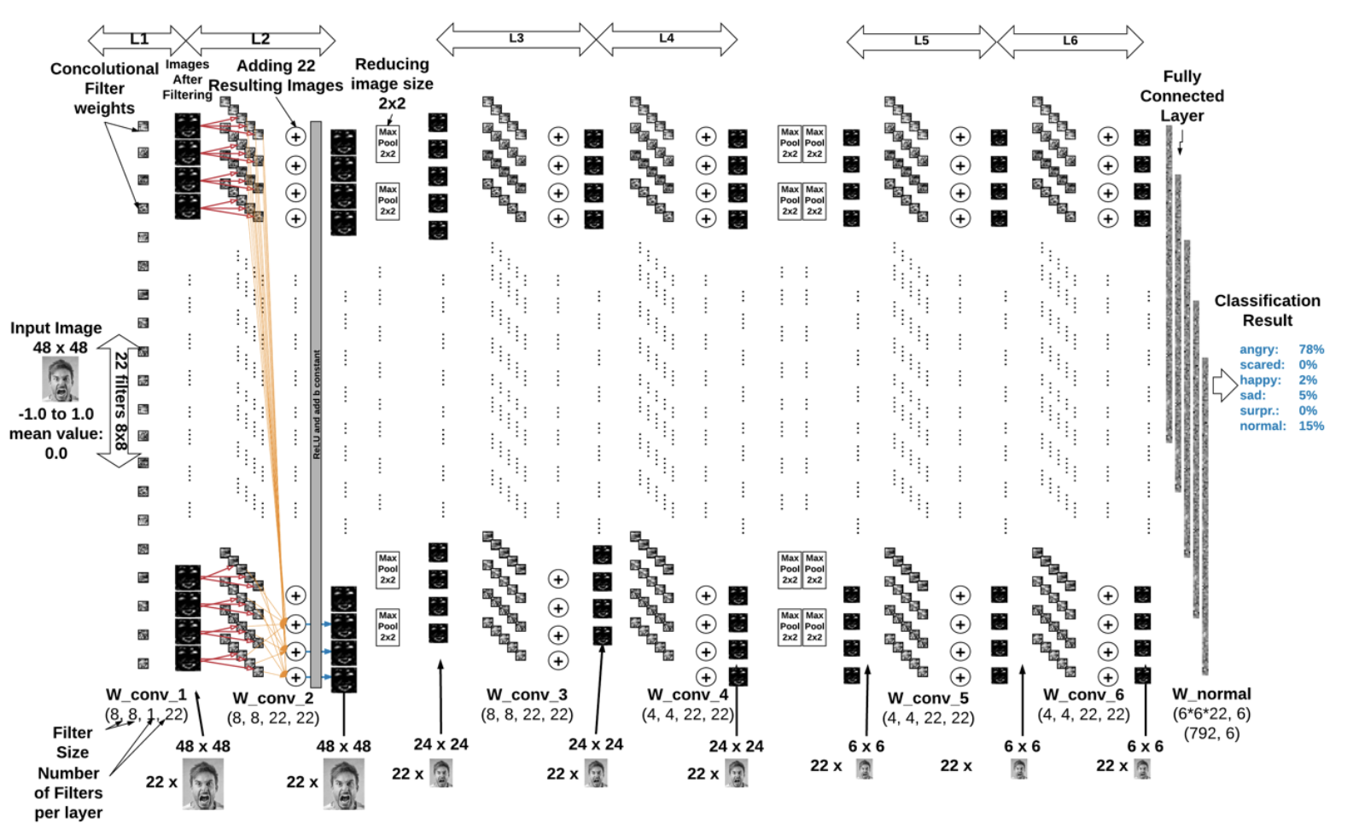
About this template
CNN Architecture
3. Model 3: Computational graph - 6 Layers, Conv-Relu-Maxpool, 1 Fully Connected
Figure [24] The chosen model

Slide 23
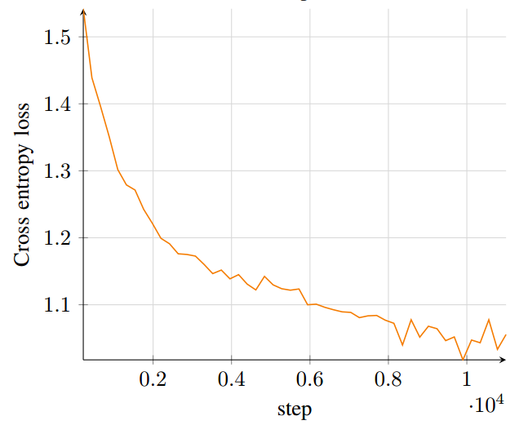
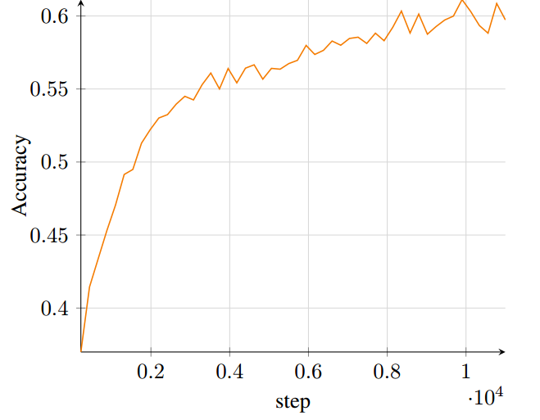
About this template
CNN Architecture
3. Model 3: Computational graph - 6 Layers, Conv-Relu-Maxpool, 1 Fully Connected
Figure [25] Cross entropy loss graph
Figure [26] Accuracy of chosen model
Comment
This second model reaches a test accuracy up to 62% which is the best result could be got. Model have prevented the overfitting problem observed with the previous models.

Slide 24
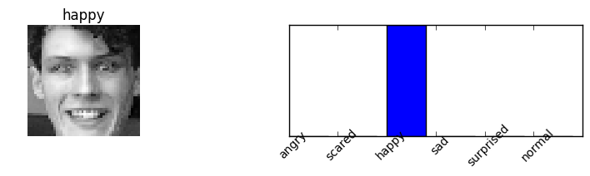
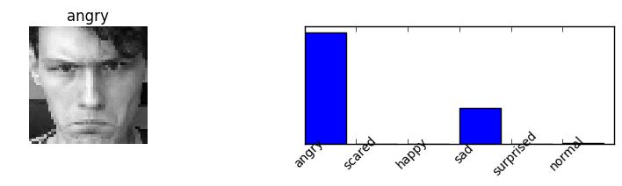
About this template
CNN Architecture
3. Model 3: Computational graph - 6 Layers, Conv-Relu-Maxpool, 1 Fully Connected
Result:
Emotion | Accuracy
angry | 0.6956
scared | 0.5714
happy | 0.3157
sad | 0.3157
surprised | 0.7272
normal | 0.4545
Table [27] Model Result
Table [28] Testing sample

Slide 25
About this template
CNN Architecture
3. Model 3: Computational graph - 6 Layers, Conv-Relu-Maxpool, 1 Fully Connected
Compare to other methods:
Method | Accuracy | Test sample quantity
Shima [29] | 62.4% | 3589
Anonymos SVM [30] | 59.8% | 3589
Proposed method | 61.8% | 3000
Figure [31] Compare to other methods
Source: [29] Shima A., Azar F. Convolutional Neural Networks for Facial Expression Recognition. Proceedings of the Stanford University report
http://cs231n.stanford.edu/reports/2016/pdfs/005_Report.pdf.
[30] Amine Horseman SVM for Facial Expression Recognition. A demonstrate project using SVM

Slide 26
About this template
CNN Architecture
1, Conclusions and comments
The data contains a lot of noisy data, i.e. faces are rotated and of different size.
A lot of emotions in the dataset were labeled wrong. (e.g. happy images in sad images).
(I think) That is why we couldn't achieve very good accuracy.
The accuracy is very good for "Happy" and "Surprised" class. These images seems to be the most "clean" as data.
The computational power to train CNN is very high, therefore it was very time consuming to try different computational graphs.
The facial emotion recognition is has very complicated features that were hard to explore for our computational graphs.

Slide 27
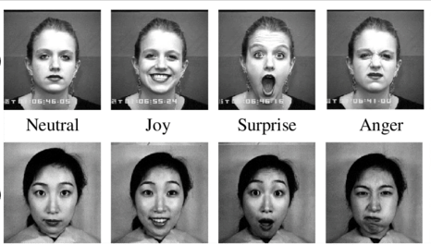
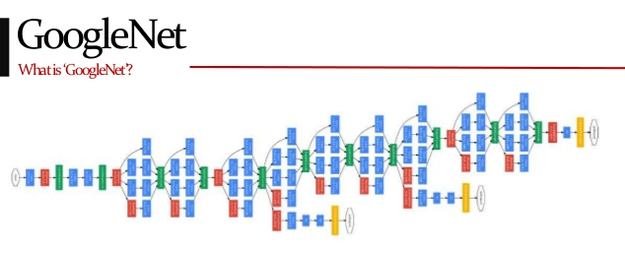
About this template
CNN Architecture
2, Possible improvements in the future
For sure the CNN would perform better if the faces were always the same size and aligned straight.
We could try another, deeper CNN architectures to extract more features.
Figure [32] CK+ Dataset
Figure [33] GoogleNet architechture
Source: [32][33] Internet
Source: [25] Shima A., Azar F. Convolutional Neural Networks for Facial Expression Recognition. Proceedings of the Stanford University report
http://cs231n.stanford.edu/reports/2016/pdfs/005_Report.pdf.
[26] Amine Horseman SVM for Facial Expression Recognition. A demonstrate project using SVM

Slide 28
Hardware Design

Slide 29
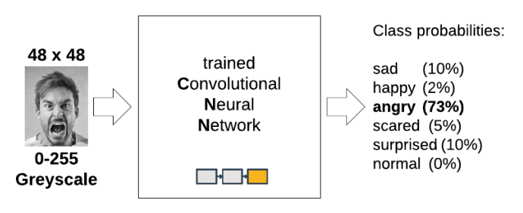
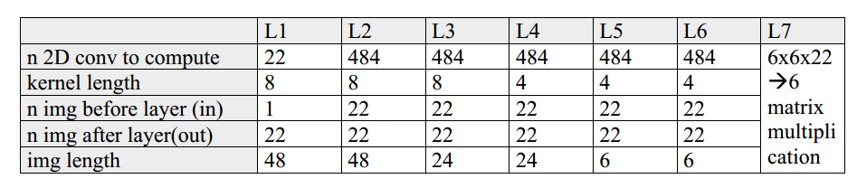
About this template
CNN Architecture
3. The Trained CNN Model
Figure [34] Overview the CNN

Slide 30
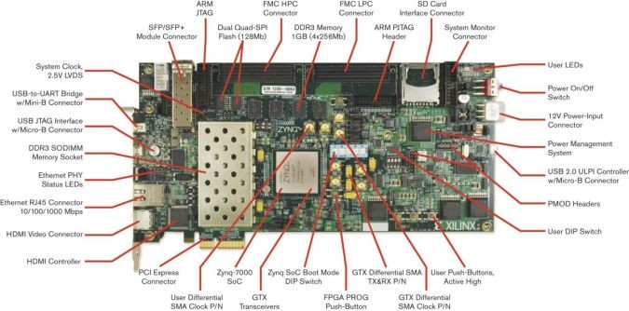
About this template
Xilinx Zynq-7000 SoC ZC706
 | XC7Z020-CLG484-1
Logic Cells (K) | 350
Block RAM (Mb) | 19.1
DSP Slices | 900
Maximum I/O Pins | 362
Figure [35] Xilinx Zynq-7000 SoC ZC706
Figure [36] Xilinx Zynq-7000 SoC ZC706 resource
Source: [35][36] Xilinx, https://www.xilinx.com/products/boards-and-kits/ek-z7-zc706-g.html

Slide 31
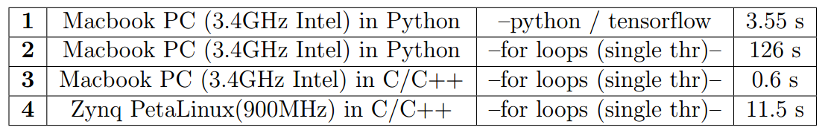
About this template
CNN Architecture
Profiling on a PC and Embedded Platform
The python and C/C++ implementations of the algorithms were used to identify the
classification time for each of them and understand the acceleration
The execution in python/tensorflow on a PC is very fast as for the high-level language, since the library is well optimized. The python code (1.) is high-level, it’s very close to the C++ (3.).
Execution 3. Is the fastest, because it’s executed on the fastest machine and the code is most low-level (C++).
Table [30] Time consuming after Profiling on a PC and Embedded Platform

Slide 32
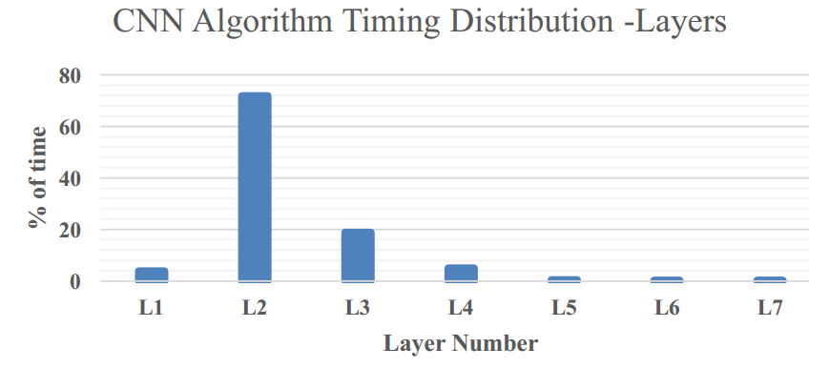
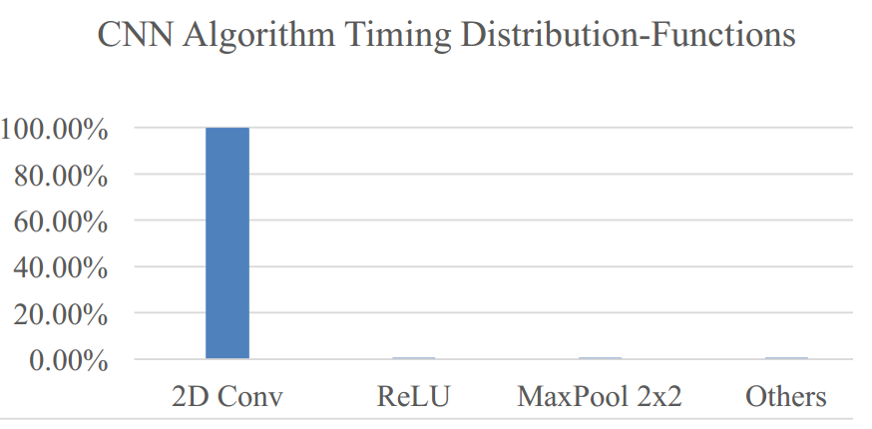
About this template
PC and Embedded Platform
Profiling on a PC and Embedded Platform
To identify the bottlenecks of the algorithm, the profiling was executed on the C-code.
The results for each layer are shown below
Table [a] Timing consumption of each layer
Table [b] Time consumption of each type of layer
Table [37] Time consuming after Profiling on Embedded Platform of each layer

Slide 33
About this template
PC and Embedded Platform
Conclusions:
Acceleration of the following functions should visibly shorten the classification time:
2D image convolution, because it’s the most computationally heavy task executed with the most of time.
ReLU, because it’s very easy to implement it in the FPGA as a multiplexer (if x<0 assign 0, else assign x).
Since we need to share a lot of data, it’d be valuable to design a solution that would also minimise this communication and therefore minimise the accelerator ⬅➔ processor time.

Slide 34
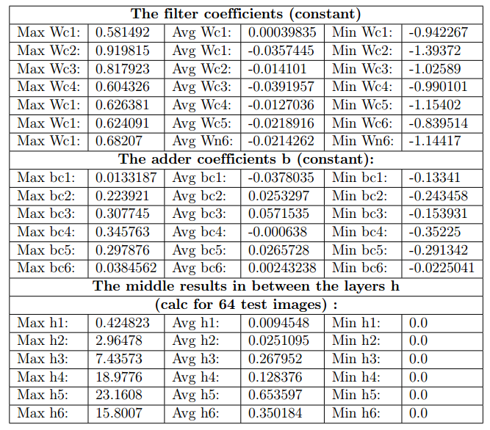
About this template
Quantization
Reason
Because they cannot easily handle the floating-point operations, the usual requirement for signal processing using FPGA is quantization.
The quantisation sweep was performed for the following fixed-point schemes:
2.5 to 2.10 - max values: (-2,2)
3.5 to 3.10 - max values: (-4,4)
4.5 to 4.10 - max values: (-8,8)
5.5 to 5.10 - max values: (-16,16)
The fixed point fractional values from .5 to .10 represent steps from 0.03125 to 0.00097.
Table [38] Min, avg and max values of the coefficients and example inter-layer results.

Slide 35
About this template
Quantization
The following experiment in C++ on float coefficients was performed:
1. Prepare the set of 64 test images.
2. Classify each of the image and obtain the classification probabilities for each class.
3. Quantise the coefficients with the certain, signed fixed-point scheme.
4. Perform the CNN algorithm on the same 64 test images, with the quantized coefficients from 3. and “flatten” each of the resulting imaged after each layer, according to maximum value that the signed point can store.
5. Compare the 64*6 class probabilities with results from 2. and calculate the mean and max error.
that all the probability values was taken into consideration when calculating the error. As an example, if the original classification probabilities were [ 0.1 0.1 0.5 0.2 0.0 0.1] and the result after quantisation was [0.0 0.0 0.55 0.45 0.0 0.0 ], the mean error is 0.108 (0.65/6) and the maximum error os 0.25 (0.45-0.2).

Slide 36
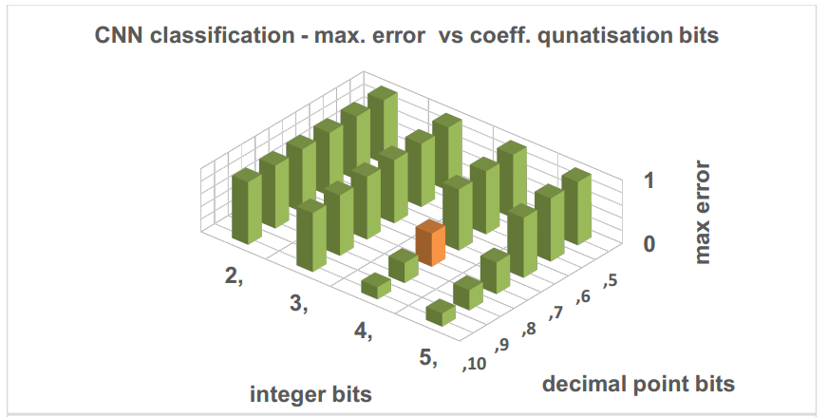
About this template
Quantization
Table [39] Plots showing relative error vs. different fixed-point quantisation.

Slide 37
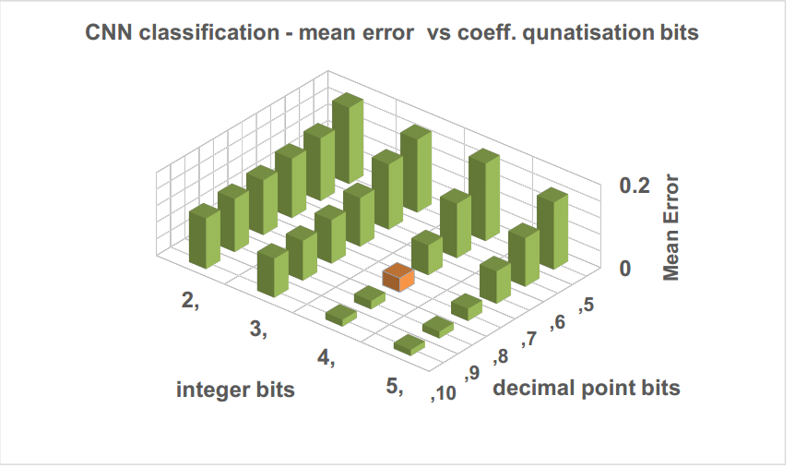
About this template
Quantization
Table [40] Plots showing relative error vs. different fixed-point quantisation.

Slide 38
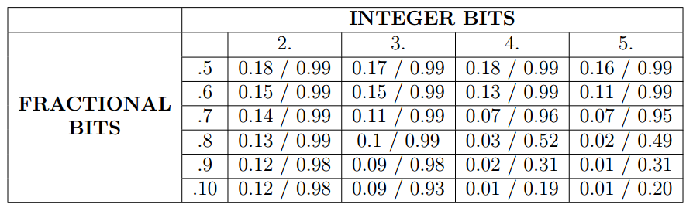
About this template
Quantization
Table [41] The result of quantization.
The quantisation error drops dramatically when increasing the number of bits. The best trade-off between the number of bits and reasonable error is fixed point 4.8.
That is why all the future accelerators will be done for 12 bit fixed-point (4.8) per pixel.

Slide 39
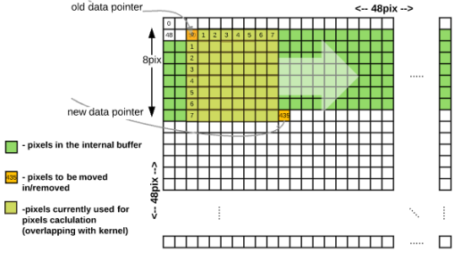
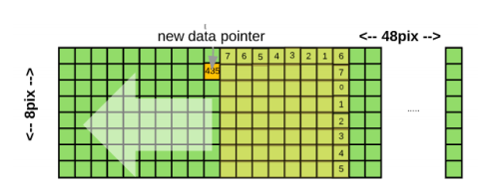
Convolution Acceleration
About this template
The main purpose in the FPGA acceleration is operation parallelization
The operation used here is multiplication – accumulation
Solution 1
The simplified idea is shown in figure below.
Figure [42] Block diagram showing the main idea of solution 1.
Characteristics:
1 output pixel per clock cycle (after filling the buffer at the beggining).
64 Multiplications and additions done at a single clock cycle.

Slide 40
Convolution Acceleration
About this template
Solution 1
Drawbacks:
The pixels shifting logic is very complicated and takes a lot of resources
The design takes 70% of the FPGA LUT/FF resources and most of it is for pixel shifting logic.
The maximum clock frequency has been set as ~70MHz
With the aforementioned characteristics, the estimated classification rate is every 0.5s.

Slide 41
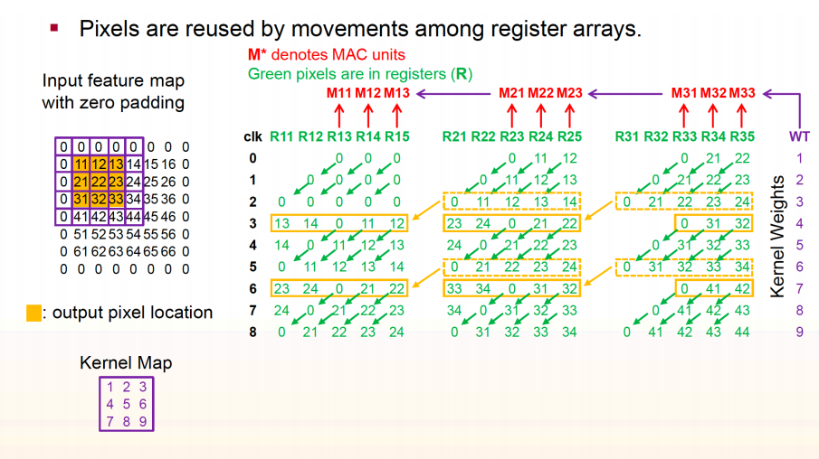
Convolution Acceleration
About this template
Solution 2
The idea of this solution is inspired from the paper “Optimizing Loop Operation and Dataflow
in FPGA Acceleration of Deep Convolutional Neural Networks [43]
Figure [44] Slide taken from [43] showing the way of pixel re-utilization and parallelization. This example is based on 9-pixel kernel (3x3) and 9-pixel block (3x3).
Source: [43] Yufei Ma et al., Optimizing Loop Operation and Dataflow in FPGA Acceleration of Deep Convolutional Neural Networks, Arizona University.

Slide 42
Convolution Acceleration
About this template
Solution 2
Note:
After 9 clock cycles, the convolution results of 3x3 block of pixels is available in the DSPs. Moreover, the same pixel shifter can be used to use it with another sets of DSPs and another sets of Kernels to compute another block results in parallel.
The decision about the exact level of parallelization was determined on basis of the number of DSPs. In particular, 900 DSPs are available.
The CNN algorithm has image sizes of 48x48, 24x24, 6x6 ⇨ it makes sense to make the single block size (that is computed as single convolution result after N clock cycles) as 6x6
The CNN has 22 images as input/output, ⇨ use 6 * 6 * 22 = 792 DSPs. This means, 88% of the available DSPs are utilized.

Slide 43
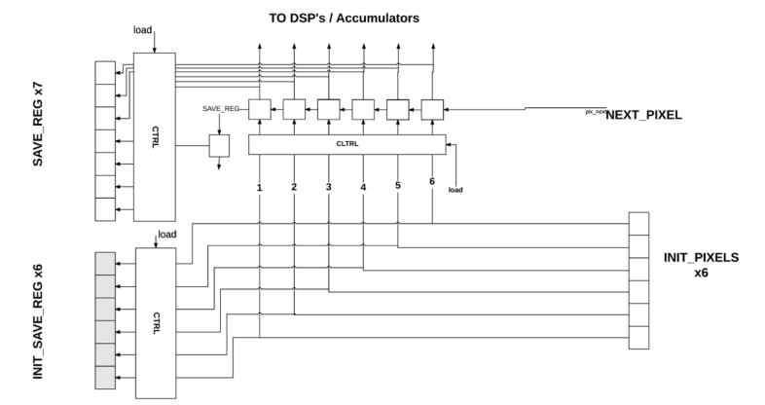
Pixel Shifting Logic
About this template
Figure [45] Block Diagram of the single block pixel shifter.

Slide 44
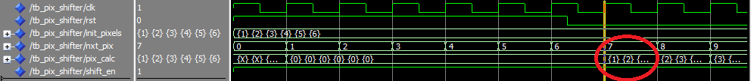
Pixel Shifting Logic
About this template
Figure [46] Test Bench showing basic operation of the pixel shifter.
Each pixel shifter is responsible for 6 pixels ⇨ 6 of them to shift 6x6 block image. The pixels are loaded from BRAM at the first cycle, and then only last pixel shifter takes the image from different image BRAMs and all others are taking the values from the previous block.

Slide 45
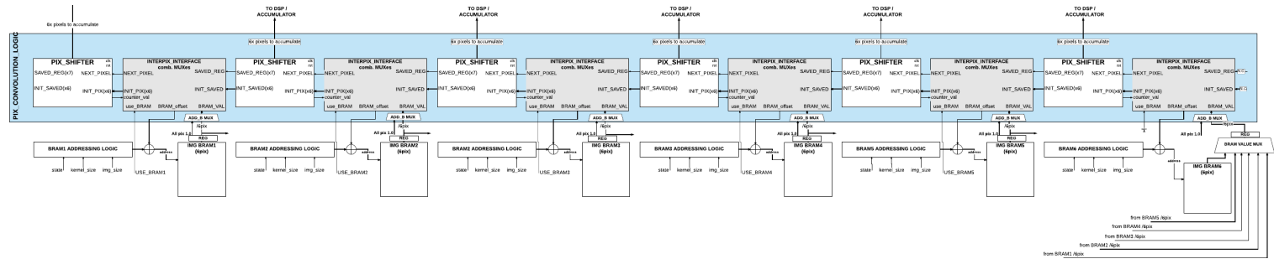
Pixel Shifting Logic
About this template
Figure [47] Diagram Showing details of pixels shifting logic.
Each pixel shifter block needs to store 7 + 6 = 13 pixels. In the pixel logic there are 6 pixel shifter, so all the logic need only 13 * 6 = 78 registers storing 12-bit pixels.
Between single pixel shifter, there are combinatorial interfaces (grey) that are set of multiplexers that are interfacing the data between pixel shifters.

Slide 46
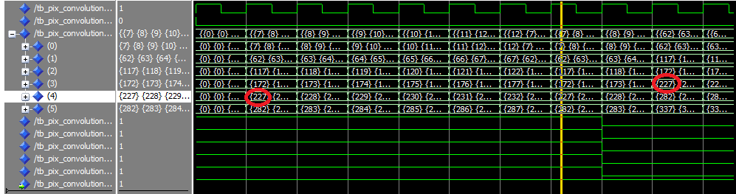
Pixel Shifting Logic
About this template
Figure [48] Test Bench showing pixel shifting logic.

Slide 47
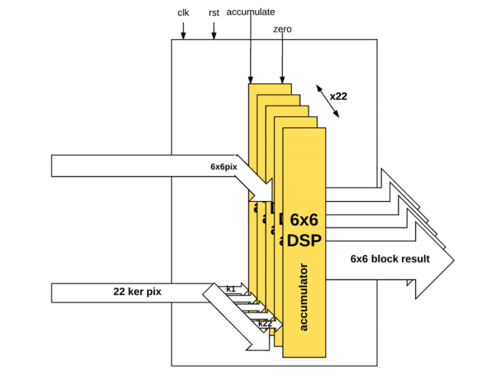
Pixel Multiplication / addition
About this template
The accumulator design handles maximum and minimum value saturation and after each cycle updates the result at the output. When accumulate enable signal is turned off, the output result is still available.
ReLU Rectifier in Hardware
The function is simply a hardware realization of y = max(x,0) in signed 12 bits
Figure [49] Block diagram of the pixel accumulator block (792 DSPs).

Slide 48
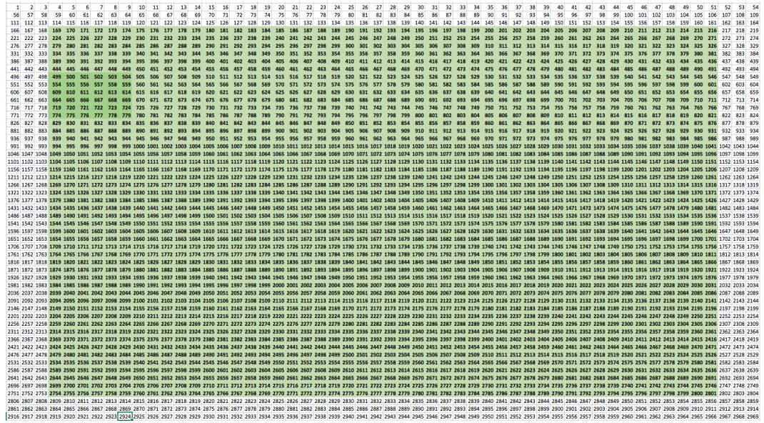
Zero Padding
About this template
the image size in the BRAM is 54 x 54 pixels.
BRAM Image Structure
In first 8 cycles of the single block computation each pixel shifter can take the data only from single BRAM image (apart from the last one) and so that there is no repetitive data in BRAMs
⇨ there are 6 BRAMS and each BRAM cell stores 6 pixels (72 bits).
Figure [50] Zero padding mapping.

Slide 49
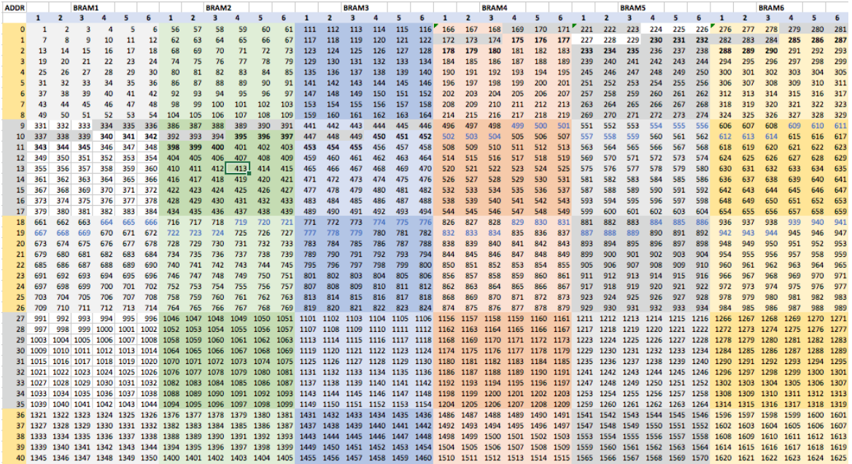
BRAM Image Structure
About this template
Figure [51] Single image BRAM structure (in 6 image BRAMS).

Slide 50
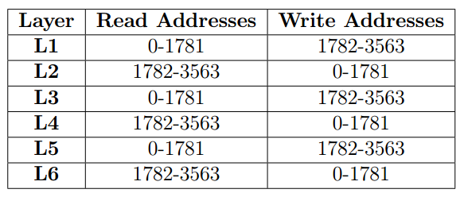
BRAM Image Structure
About this template
BRAM Image Structure
It’s needed to store 22 full images; therefore, it takes 81* 22 = 1782 addresses.
The BRAM is divided into 2 sectors of the 22-image size and for different layers images are read and write in the swapped sectors
Figure [52] Addressing of different image sectors.

Slide 51
BRAM Image Structure
About this template
BRAM addressing
BRAM needs to store 72 bits per cell, its size been configured to 128 bits to be able to handle it from the processor side easily. The 72 image pixels are aligned to LSb and MSb’s are padded with 0’s.
Since the address of the BRAM is byte aligned ⇨ The real address that the image should be should be written or read is shifted left (padded 0’s) 4 bits
⇨address 81 (0x51) will become 1296 (0x510)
Kernel BRAMs
The kernel shifting logic had only been designed for 8x8 kernels, x
⇨The 4x4 kernels for layers L3-L6 has been padded by 0’s and used as 8x8.
Each kernel is 8x8 = 64 pixels and 22 kernel results are parallelized
The kernel pixels are also 12 bits, and it’s need 22 of them in one cell to be read in parallel. ⇨12 * 22 = 264
The BRAM cell size needs to be the power of 2 ⇨ the BRAM cell size has been chosen as 512 bits
1st layer uses only 22 kernels but L2-L6 uses 484 kernels each
BRAM kernel cells is 64 * 1 + 5 * 64 * 22 = 7104
6 b constants for each layer, are stored at the end of the BRAM size
⇨ final number of cells is 7104 + 6 = 7110

Slide 52
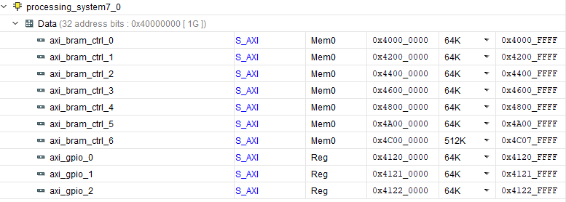
BRAM Image Structure
About this template
Kernel BRAMs
It is possible to access each 32-bit part of the BRAM cell with the byte-aligned addressing.
The address space is shown below:
Figure [53] Kernel and BRAM address space in AXI bus.

Slide 53
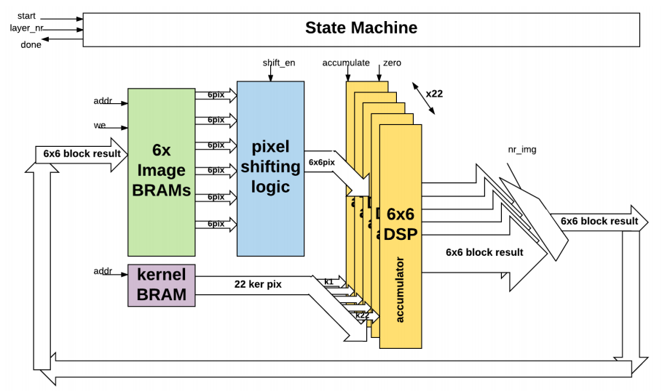
State Machine
About this template
The block diagram of the full accelerator system and state machine is shown below
Figure [54] Simplified Block Diagram of Solution 2.

Slide 54
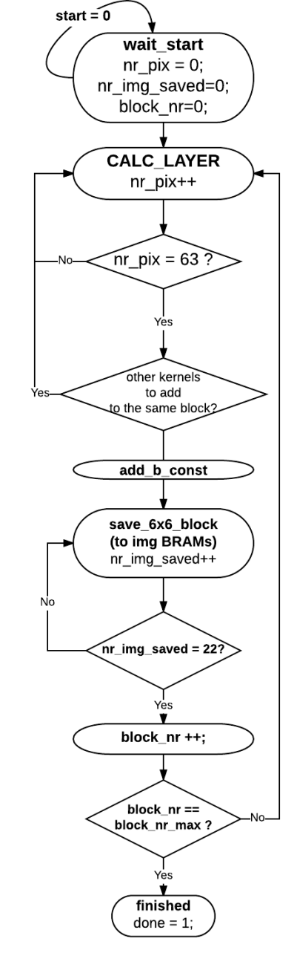
State Machine
About this template
The main purpose of the state machine is to manage the addresses of the BRAMs, based on layer number (which determines image size, sector to R/W, number of input images etc.) and control the pixel shifting logic, DSPs and writing the result.
Nr_pix – counts from 0 to 63, when the DSPs are accumulating the kernel result.
Nr_img_saved – from 0 to 21, when saving the images needed to iterate through the DSP results.
Block_nr (block_row and block_col) – the results are computed in 6x6 blocks and each image has 8x8 blocks (for 48x48 image), 4x4 blocks (for 24x24 image) or 1x1 block(for 6x6 image).
States:
Wait_start – waiting for start signal. Connected to GPIO.
CALC_LAYER – wait for the result, change the kernel pixels and shift the pixel values.
Add_b_const – puts the kernel address to point to the b constant for the current layer and make them accumulate it in the DSP (the pixels at this point are multiplexed to be 1.0, and therefore the DSP_value += pixel_value * b_const(from kernel BRAM), pixel value = 1.0 so DSP_value += b_const.
Figure [55] Simplified State machine Diagram of Solution 2.

Slide 55
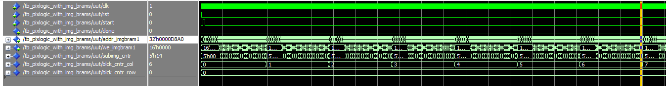
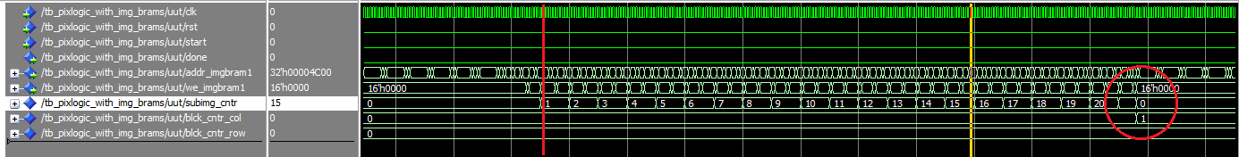
State Machine
About this template
The test bench for the whole accelerator design, as an example for L1, is shown below:
Figure [56] Test bench of the accelerator logic.

Slide 56
About this template
Block Design with ZynQ processor
To be able to load the kernel coefficients and images, each BRAM ports 1 has been connected to the BRAM controller (connected to AXI bus and ZynQ) and BRAM ports 2 to the accelerator. The accelerator start, reset and layer_nr signals are managed by connecting it into a GPO, as well as the done signal to GPI.

Slide 57
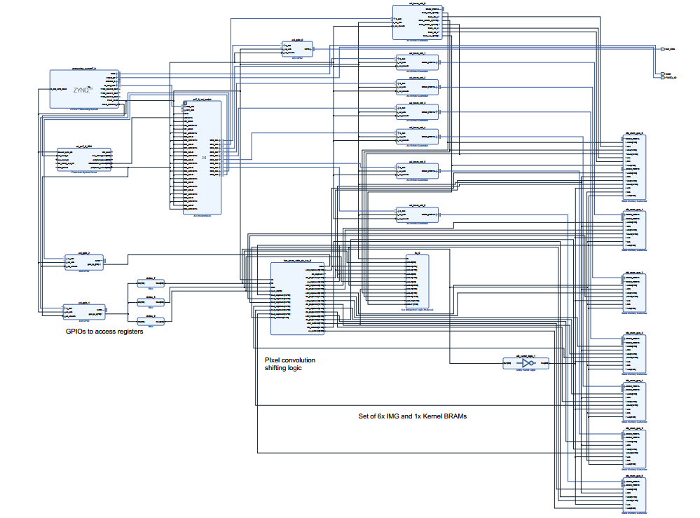
About this template
Figure [57] System block diagram with BRAMs and ZynQ processor.

Slide 58



Evaluation of Solution 2
About this template
Figure [58] Resources Utilization of the ZynQ processor.
Observations:
FPGA Frequency : 110MHz
792 DSPs are utilised.
896kB of BRAM space is used.
Figure [59] File Netlist of proposed Zynq.

Slide 59

Evaluation of Solution 2
About this template
To check the timing of the solution, a ZYNQ software has been used to trigger the start of the accelerator for different layers. The timing results are shown below.
Figure [60] Final acceleration results of Sol 2- Timing.

Slide 60

Evaluation of Solution 2
About this template
Figure [61] Timing Results After Acceleration of Solution 2.

Slide 61
Results and Conclusions
About this template
Acceleration ratios
The current acceleration results the 2D convolution is not a bottleneck any more. Thanks to multiple DSP utilization and smart pixel shifting logic the amount of time to compute convolutions and image accumulations results was reduced massively
Analyzed the computational graph of the CNN.
The difficulty was mainly to understand the high-level functions used in python / tensorflow and to map it into the C code executable efficiently on the embedded platform.
Profiled the CNN algorithm
After implementing fully functional classification algorithm in C, it was possible to precisely profile which operation was the bottlenech of the classification. That is why it was discovered that the 2D image convolution take more than 99% of the classification time.

Slide 62
Implement Result

Slide 63
Results
About this template
Made the quantization analysis
Generated coefficients with different quantization levels and executed the algorithm with “flattening functions” to simulate the DSP behaviors. Then compared the generated classification errors in comparison to the “not quantized/flattened” coefficient solutions.
Reviewed different accelerator architectures.
During the project, multiple designs of convolution acceleration has been reviewed and the solutions appropriate to the platform, the CNN and the level of complexity for the semester project has been chosen.
Implemented and reviewed simple Solution 1
Implemented and reviewed Solution 2
Python Software to Generate the Constants in *.h file

Slide 64
Research paper
About this template
Hanh Phan-Xuan, Thuong Le-Tien, Sy Nguyen-Tan (2019). FPGA Platform applied for Facial Expression Recognition System using CNNs.
This work was accepted for oral presentation and published in The 2nd International Conference on Emerging Data and Industry 4.0 (EDI40 2019) in Belgium.
Beside Elsevier publisher also selected this work to publish on “The 2nd International Conference on Emerging Data and Industry 4.0 (EDI40 2019) /Aliated Workshops”, Procedia Computer Science, ISSN= 1877-0509, Vol. 151, pp. 651-658. Indexed by Scimago.

Slide 65
Conclusion

Slide 66
Challenges and future work
About this template
Implement Max Pooling in hardware
⇨If I can reduce the bottleneck of MaxPooling (implement it in hardware), the acceleration results can be obtained much faster, i.e. at least every ~3ms.
Make 4x4 kernels pixel shifting logic
Currently the pixel shjifting logic is working only for 8x8 kernels and 4x4 kernels are padded by 0’s and treated as 8x8 kernels. The number of computations required for computing 4x4 kernels is much smaller (single block result in 16 not 64 cycles)
⇨the obtained acceleration could be up to 8 times faster for L4-L6
Improve the model accuracy

Slide 67
About this template
References
D. Ververidis, and C. Kotropoulos. (2004) "Automatic speech classification to five emotional states based on gender information " Proceedings of the EUSIPCO2004 Conference, Austria: 341-344.
Cowie, R., Douglas-Cowie, E., Tsapatsoulis, N., Votsis, G., Kollias, S., Fellenz, W., and Taylor. (2001) "Emotion recognition in human computer interaction " IEEE Signal Processing magazine, Vol. 18, No. 1: 32-80.
Yann LeCun, Yoshua Bengio, and Georey Hinton. (2015) “Deep learning.” Nature. Vol.521: doi 10.1038/nature14539.
Amine Horseman. (2007) "SVM for Facial Expression Recognition." A demonstrate project using SVM.: https://github.com/amineHorseman/facial-expression-recognition-svm/commit/aecd525367f6d77e5d274de7c6f0166d5bfa4bb9.
Shima A., Azar F. (2016) “Convolutional Neural Networks for Facial Expression Recognition.” Proceedings of the Stanford University report.: 3-4. http://cs231n.stanford.edu/reports/2016/pdfs/005_Report.pdf.

Slide 68
Demo

Slide 69
Thank you for your attention!
Department of EEE, Ho Chi Minh City University of Technology, Vietnam.
You can find me at:
tansyab1@gmail.com
Tel.: +84-964-025-859

